Slide 1
AI-Driven SAP Balance Prediction and Analysis

Slide 2

The Business Problem
Business users involved in the review of Month-End Balances encounter several challenges when trying to assess and finalize their Month-End close procedures.
Time Constraints
Users face timelines and deadlines spanning only several days
Late adjustment booking can occur if there are multiple anomalies or errors that need to be corrected
Posting late adjustments requires multiple levels of approval, and delays or file rework for downstream teams
Potential for Error
Most book review is done manually
If incorrect balances or missing journals are overlooked, regulatory refiling, potential for audit points, or a penalty can result
Time constraints and deadlines only increase the probability of overlooking errors

Slide 3
Transforming Financial Operations with GenAI
Utilize GenAI for accurate forecasting of SAP balances.
Begin predictive analytics on the 25th of each month to get ready for the month-end.
Detect anomalies when predicting balances from the 25th to the end of the month.
Minimize manual errors and improve financial procedures.
Strengthen decision-making with timely insights.
Automate commentary to speed up the report creation process.
Increase the efficiency of financial reporting.
Notes:
This slide outlines how GenAI can transform financial processes by predicting SAP balances starting from the 25th of the month. By reducing manual input, we can minimize errors and support quicker decision-making, ultimately enhancing the efficiency of financial operations.

Slide 4







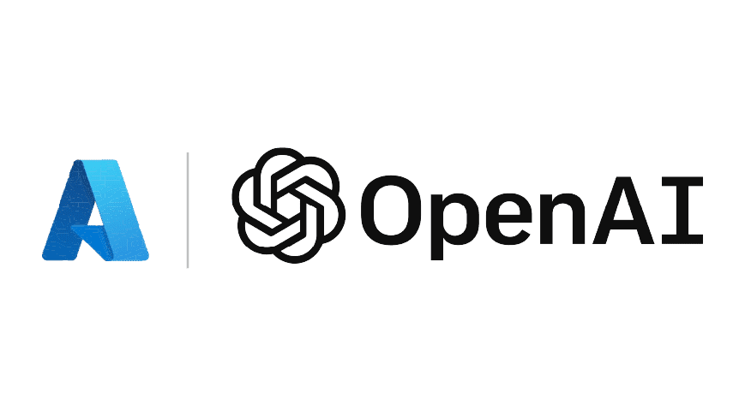



Solution architecture
Extracted sample dataset
Generated Python code
Query
GPT-4
GPT-4
Multi-year SAP dataset
User
UI
Run LLM Model on full dataset
Response
Generate insights and commentary
Predicted dataset

Slide 5
Demo

Slide 6
Key Benefits of GenAI Integration
Increased accuracy in financial reporting and analysis.
Significant time savings in routine data analysis.
Early identification of ANAMOLIES in financial data.
Improved consistency in reporting through commentary automation.
Ahead of month-end, it predicts the SAP balances that need to be posted
Notes:
This slide highlights the key benefits of integrating GenAI into financial processes. By increasing accuracy, saving time, and enhancing reporting consistency, organizations can streamline their financial operations and improve confidence in decision-making.

Slide 7
Future State for Scalability
Implementing cloud infrastructure to enhance capacity and flexibility.
Utilizing modular architecture for easy feature expansion.
Integrating advanced AI tools for predictive analytics and insights.
Establishing a robust API framework to enable third-party extensions.
Focusing on continuous improvement through agile development methodologies.
Notes:
In this slide, we will explore the future plans for scalability of the project. Key enhancements include the adoption of cloud infrastructure, which will provide flexibility and increased capacity. Modular architecture will allow for easy feature expansion, while advanced AI tools will offer predictive analytics. Additionally, a robust API framework will facilitate third-party integrations, and we will adopt agile methodologies for continuous improvement.

Slide 8
Thank you
Any Questions?

